Slide 1

Foundations of Machine Learning Frameworks
CSCN8010 - Winter 2024 - Section 1
Final Project: Alzheimer Prediction with MR Images
Group Name: Final Project 15
Group members:
Joseph, Sachin
Fernandez, Arcadio
Professor:
Ran Feldesh

Slide 2
1. Problem Statement (Objective, Motivation, Method)
According to the World Health Organization, in March 2023, there are more than 55 million people who have dementia worldwide. Dementia results from a variety of diseases and injuries that affect the brain. Alzheimer's disease is the most common form of dementia and may contribute to 60–70% of cases, so we are talking about 33 to 38.5 million people.
Our objective is to analyze an Alzheimer's Magnetic Resonance Imaging (MRI) preprocessed Dataset using Machine Learning algorithms to identify a person's dementia stage.
2. Interesting Choice of Problem
Although no treatment can revert Alzheimer’s disease, Rasmussen et al. (2019) asserted that a diagnosis early in the course of illness allows time for all concerned to adjust while the patient can still actively engage and offers access to advice, financial support and non-pharmacological and pharmacological treatments.
Because of this our project proposes to deal with this issue of early diagnosis by identifying through the images of patients with Very Mild Demented, Mild Demented, Moderate Demented or Non-Demented.

Slide 3
3. Reasonable (Doable) Choice of Problem
The key categories of applications of artificial intelligence (AI) in healthcare, according to Davenport et al. (2019), involve diagnosis and treatment recommendations, patient engagement and adherence, and administrative activities. So, by choosing the Alzheimer's MRI project, we correspond to the necessity of the healthcare industry to use AI to diagnose and make treatment recommendations.
4. Review of the Data Source
After going through many datasets on Kaggle, we discovered the Alzheimer MRI Preprocessed Dataset, with a usability of 8.75 and 11,044 downloads (06/04/23). The Dataset contains 6400 MRI images collected from several sources. All the images are resized into 128 x 128 pixels; the Dataset has four classes of images.
https://www.kaggle.com/datasets/sachinkumar413/alzheimer-mri-dataset/data
5. Indication of Reference Code
On Kaggle at Alzheimer MRI Preprocessed Dataset, there are 70 codes and one caught our attention because of its organization, the use of CNN and the way the result is exposed:
https://www.kaggle.com/code/amyjang/alzheimer-mri-model-tensorflow-2-3-data-loading
https://www.kaggle.com/code/ahmetesencan/alzheimer-mri-classification-using-cnn

Slide 4
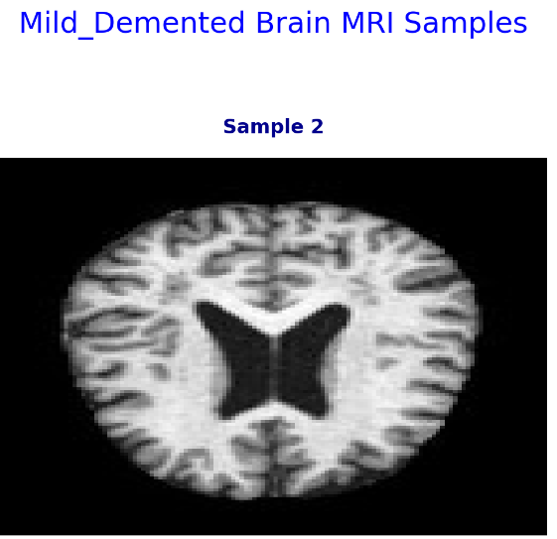
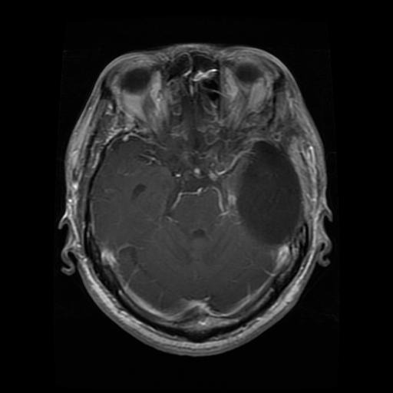
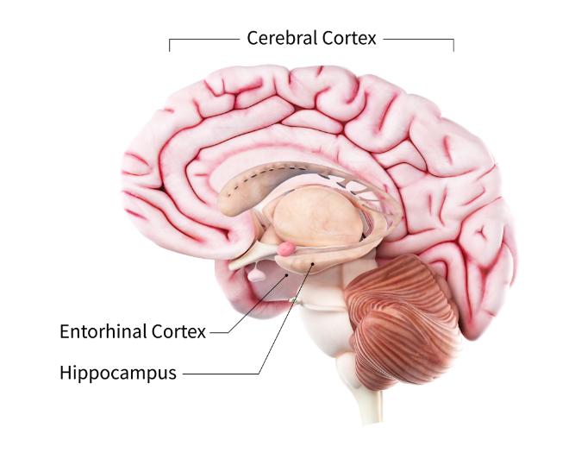
This damage initially takes place in parts of the brain involved in memory, including the entorhinal cortex and hippocampus. It later affects areas in the cerebral cortex, such as those responsible for language, reasoning, and social behavior. Eventually, many other areas of the brain are damaged.
glioma cancer

Slide 5
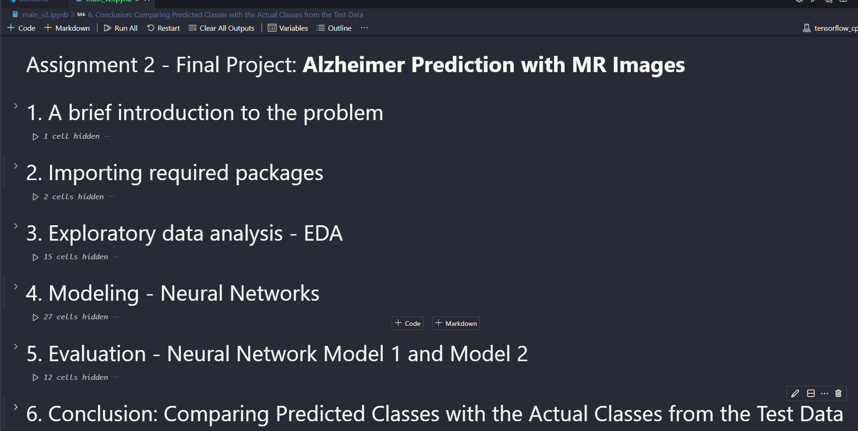

Slide 6

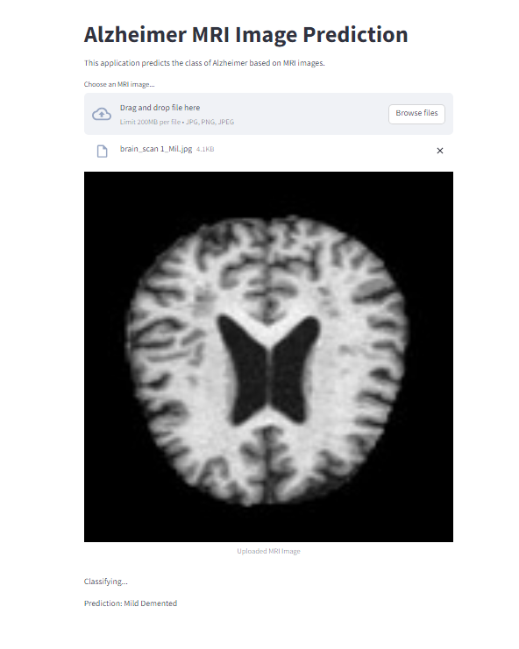


Slide 7
Reference
Davenport, T., & Kalakota, R. (2019). The Potential for Artificial Intelligence in Healthcare. Future Healthcare Journal, 6(2), 94–98. https://doi.org/10.7861/futurehosp.6-2-94
Rasmussen, J., & Langerman, H. (2019). Alzheimer’s Disease – Why We Need Early Diagnosis. Degenerative Neurological and Neuromuscular Disease, Volume 9(9), 123–130. https://doi.org/10.2147/dnnd.s228939
World Health Organization. (2023, March 15). Dementia. World Health Organisation. https://www.who.int/news-room/fact-sheets/detail/dementia

